Slide 1
Decision trees, Random Forest & XGBoost
Nathaniel Shimoni - Grid4C tutorial session 16/10/2017

Slide 2
Discussed topics:
Classification and regression using decision trees
Bagging and random forest algorithm
Boosting and xgboost implementation
Validation and analysis of results:
What is validation?
reproducibility
comparison to a benchmark/previous model
examining histograms of predictions
checking feature importance

Slide 3
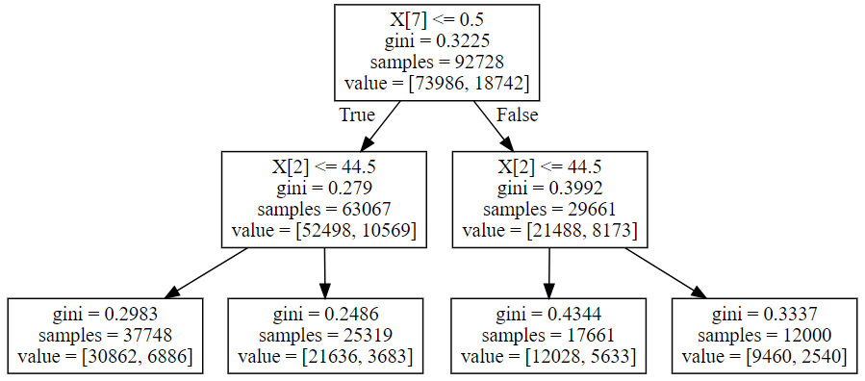
Decision tree classifier / regressor
Main idea – split by best information gain at each step
Easy to interpret & explain results (to a certain level…)
Relatively quick to train
Can perceive non linear attributes of the data

Slide 4
That’s nice, how can we improve?
Bias – variance tradeoff
Regularization
Bagging
Boosting

Slide 5
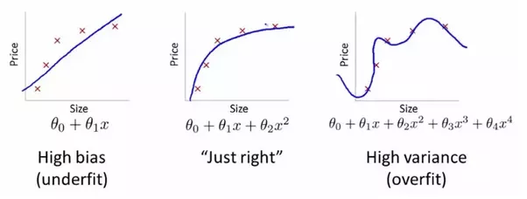
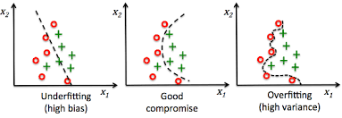
That’s nice, how can we improve?
Bias – variance tradeoff
Regularization
Bagging
Boosting
regression
classification

Slide 6
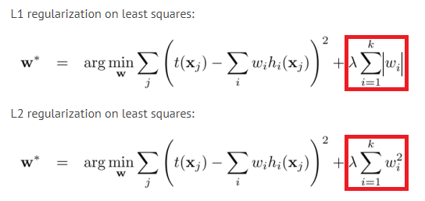
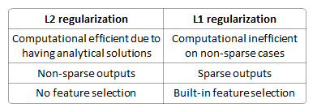
That’s nice, how can we improve?
Bias – variance tradeoff
Regularization
Bagging
Boosting

Slide 7
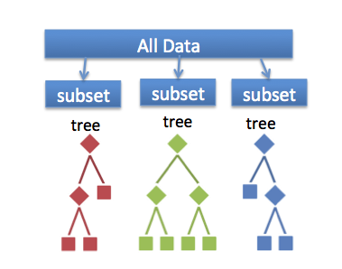
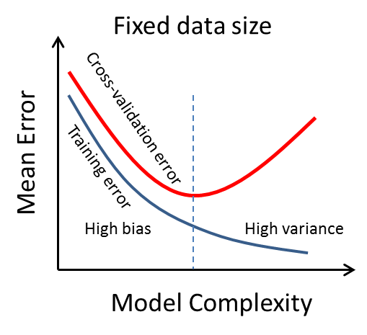
Random forest - bagging
If we’re facing overfitting that means we have too high variance
We can reduce variance using aggregation of several model runs
This is also called “bootstrap aggregating” or in short “Bagging”

Slide 8
Boosting
If we’re facing underfitting that means we have too high bias
We can increase variance (& reduce bias) by iteratively training on the prediction errors of previous iteration
This is also called “Boosting”
Note that we can deliberately cause underfitting by limiting the depth of the decision tree

Slide 9
Boosting
This method is proven to produce SOTA results as a single algorithm solution on classical (relational) datasets and is frequently used as an initial benchmark for lots of Kaggle’s data science competitions
mainly since the introduction of the xgboost library through the otto challenge

Slide 10
validation
Our way to:
Analyze our model performance & errors
Tune hyper-parameters
Set early stopping point to save time while training our models

Slide 11
Reproducibility
How can we make sure that the effect monitored is a result of a change we made and not derived from stochastic process?
Set random seed for each stochastic process
Monitor and record each change of parameter/model separately

Slide 12
Model comparison & model selection
Compare validation metrics
Compare prediction distribution
Compare feature importance
Which type of error do we prefer?

Slide 13
Lets code!
Sample data, presentation and Jupyter notebook are on:
https://github.com/nathanie/basic_yet_practical_ml_course

Slide 14
Terms
Decision tree classifier / regressor
Random forest
Xgboost
Bias-variance tradeoff, overfitting, underfitting
regularization
Bagging
Boosting
Validation (train-test-split, kfold, groupkfold, stratification)
Feature importance
Prediction histograms

Slide 15


